Slide 1
What’s New in TypeScript
@basarat
Notes:
How many people here are familiar with TypeScript
This is an intermediate level talk, that said I do pressent some premise so beginners don’t feel completely lost.

Slide 2
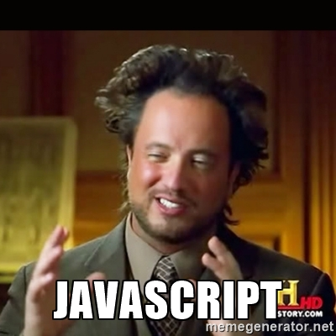

Slide 3
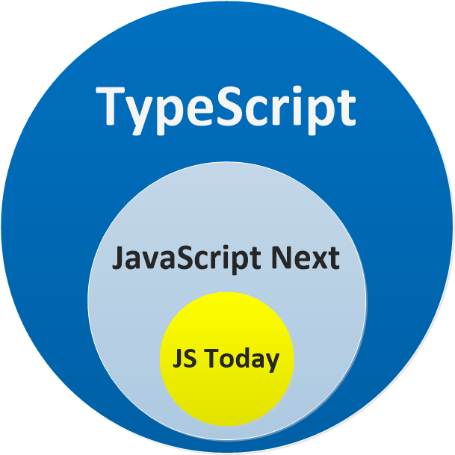

Slide 4


Slide 5


Slide 6


Slide 8
DEMOS
Notes:
Just JS demo
Demo-shipping:
A js file (hard to reason about)
Simple bugs can be hard to find
New features: Done in the last year alone!

Slide 9
Keeping up to date
Star on Github (in your stars)
TypeScript blog (ifttt)
Road Map – wiki
What’s new in TypeScript – wiki
Watch on Github (notifications)
Notes:
Key takeaways
Use TypeScript latest and its really just more free help for you and your team.

Slide 10


alm.tools
Google:
TypeScript Book
https://egghead.io/instructors/basarat-ali-syed

Slide 11
QUESTIONS

Slide 12
@basarat

